Slide 1
Efficient Memory Management for Large Language Model Serving with PagedAttention SOSP 2023
Woosuk Kwon
Zhuohan Li
Siyuan Zhuang
Ying Sheng
Lianmin Zheng
Cody Hao Yu
Joseph E. Gonzalez
Hao Zhang
Ion Stoica

Slide 2
Outline
Introduction
Background
Challenges
Method
Experiment
Conclusion

Slide 3
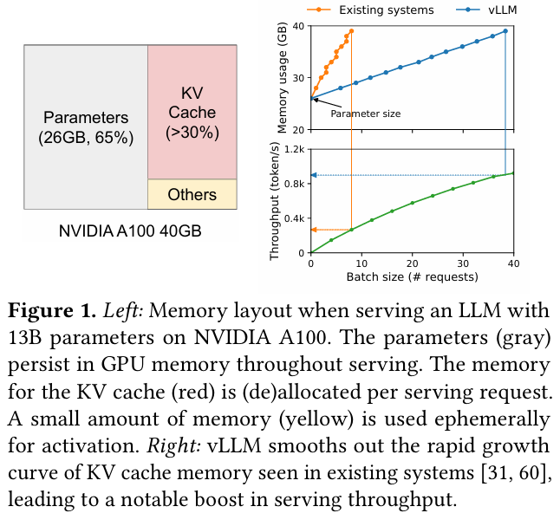
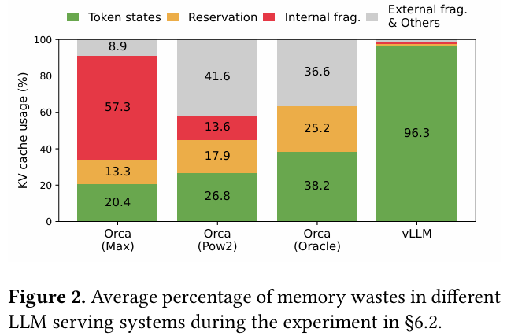
Brief Background & Challenges
More and more companies are racing to provide LLM applications like programming assistant or universal chatbot
Processing an LLM request can be 10× more expensive than a traditional keyword query
The sequential generation process of LLM makes the workload memory-bound, underutilizing the computation power of GPUs and limiting the serving throughput
To process many requests in a batch, the memory space for each request should be efficiently managed

Slide 4
Solution
Propose PagedAttention, an attention algorithm inspired by the operating system’s (OS) solution to memory fragmentation and sharing: virtual memory with paging
Divides the request’s KV cache into blocks, each of which can contain the attention keys and values of a fixed number of tokens.
The blocks for the KV cache are not necessarily stored in contiguous space
Build vLLM, a high-throughput distributed LLM serving engine on top of PagedAttention that achieves near-zero waste in KV cache memory
Evaluate vLLM on various scenarios and demonstrate that it substantially outperforms the previous state-of-the-art solutions such as FasterTransformer [31] and Orca [60].

Slide 5
Outline
Introduction
Background
Challenges
Method
Experiment
Conclusion

Slide 6
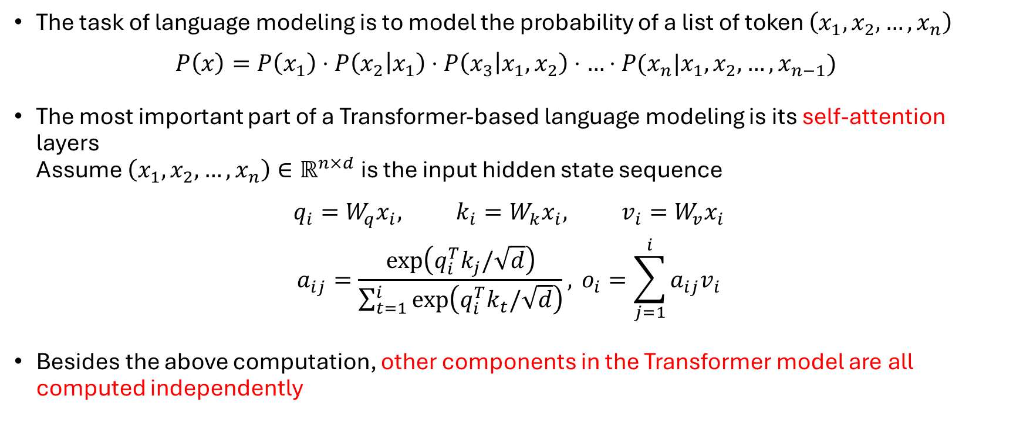
Transformer-Based LLMs
The task of language modeling is to model the probability of a list of token $\left(x_{1}, x_{2}, …, x_{n}\right)$
$$P\left(x\right)=P\left(x_{1}\right)⋅P\left(x_{2} | x_{1}\right)⋅P\left(x_{3} | x_{1}, x_{2}\right)⋅…⋅P(x_{n}|x_{1}, x_{2}, …, x_{n−1})$$
The most important part of a Transformer-based language modeling is its self-attention layers Assume $\left(x_{1}, x_{2}, …, x_{n}\right)∈ℝ^{n×d}$ is the input hidden state sequence
$$q_{i}=W_{q}x_{i}, k_{i}=W_{k}x_{i}, v_{i}=W_{v}x_{i}$$
$$a_{ij}=\frac{\exp\left(q_{i}^{T}k_{j}/\sqrt{d}\right)}{\sum_{t=1}^{i}{\exp\left(q_{i}^{T}k_{t}/\sqrt{d}\right)}}, o_{i}=\sum_{j=1}^{i}{a_{ij}v_{i}}$$
Besides the above computation, other components in the Transformer model are all computed independently

Slide 7
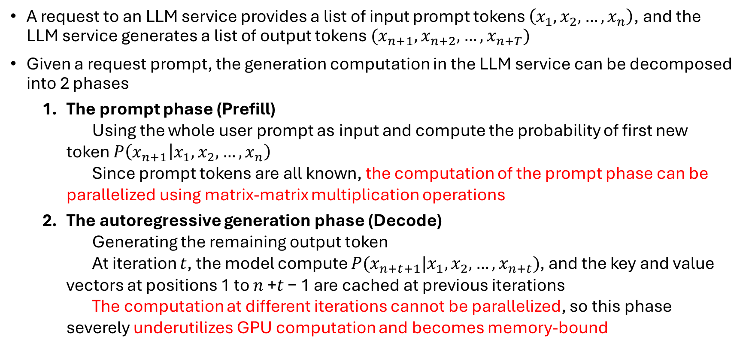
LLM Service & Autoregressive Generation
A request to an LLM service provides a list of input prompt tokens $\left(x_{1}, x_{2}, …, x_{n}\right)$, and the LLM service generates a list of output tokens $(x_{n+1}, x_{n+2}, …, x_{n+T})$
Given a request prompt, the generation computation in the LLM service can be decomposed into 2 phases
The prompt phase (Prefill) Using the whole user prompt as input and compute the probability of first new token $P\left(x_{n+1} | x_{1}, x_{2}, …, x_{n}\right)$ Since prompt tokens are all known, the computation of the prompt phase can be parallelized using matrix-matrix multiplication operations
The autoregressive generation phase (Decode) Generating the remaining output token At iteration $t$, the model compute $P(x_{n+t+1}|x_{1}, x_{2}, …, x_{n+t})$, and the key and value vectors at positions 1 to 𝑛 +𝑡 − 1 are cached at previous iterations The computation at different iterations cannot be parallelized, so this phase severely underutilizes GPU computation and becomes memory-bound

Slide 8
Batching Techniques for LLMs
The compute utilization in serving LLMs can be improved by batching multiple requests, but it is non-trivial for two reasons
The requests may arrive at different times A naive batching strategy would either make earlier requests wait for later ones or delay the incoming requests until earlier ones finish, leading to significant queueing delays
The requests may have vastly different input and output lengths A straightforward batching technique would pad the inputs and outputs of the requests to equalize their lengths, wasting GPU computation and memory
To address this problem, fine-grained batching mechanisms, such as cellular batching [16] and iteration-level scheduling [60], have been proposed. These techniques operate at the iteration level. After each iteration, completed requests are removed from the batch, and new ones are added.

Slide 9
Outline
Introduction
Background
Challenges
Method
Experiment
Conclusion

Slide 10
Memory Challenges in LLM Serving
Large KV cache The KV Cache size grows quickly with the number of requests For example, a 13B parameter OPT model[62], the KV cache of a single token demands 800 KB of space, calculated as 2 (key and value vectors) × 5120 (hidden state size) × 40 (number of layers) × 2 (bytes per FP16) Since OPT can generate sequences up to 2048 tokens, the memory required to store the KV cache of one request can be as much as 1.6GB
Complex decoding algorithms LLM services offer a range of decoding algorithms for users to select from, each with varying implications for memory management complexity For example, the KV cache for the prompt can be shared when multiple outputs are sampled from the same prompt. However, once autoregressive generation begins, each sample may produce different tokens, so their generated KV cache usually cannot be shared More advanced decoding methods, such as beam search, allow more KV cache sharing because different beams may share common prefixes. This can save more memory, but the sharing pattern changes dynamically as decoding progresses.

Slide 11
Memory Challenges in LLM Serving
Scheduling for unknown input & output lengths The requests to an LLM service exhibit variability in their input and output lengths. This requires the memory management system to accommodate a wide range of prompt lengths. Besides, as the output length of a request grows at decoding, the memory required for its KV cache also expands and may exhaust available memory for incoming requests or ongoing generation for existing prompts

Slide 12
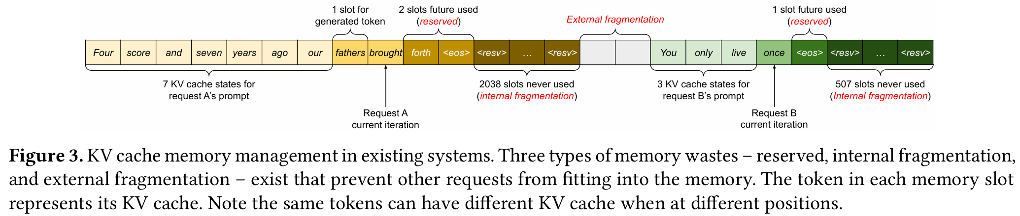
Memory Management in Existing Systems
Since most operators in current DL frameworks require tensors to be stored in contiguous memory, previous LLM serving systems also store the KV cache of one request as a contiguous tensor across the different positions.
Because LLM output lengths are unpredictable, these systems pre-allocate memory based on the request’s maximum possible sequence length, rather than its actual input or output length.
This allocation strategy leads to three types of memory waste: reserved slots for future tokens, internal fragmentation inside over-allocated request blocks, and external fragmentation caused by allocator-level gaps between blocks.

Slide 13
Outline
Introduction
Background
Challenges
Method
Experiment
Conclusion

Slide 14
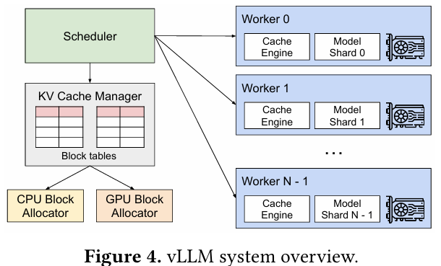
Overall Architecture

Slide 15
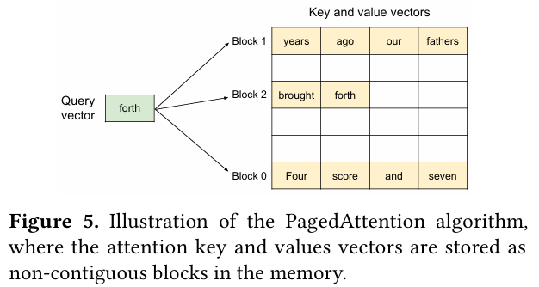
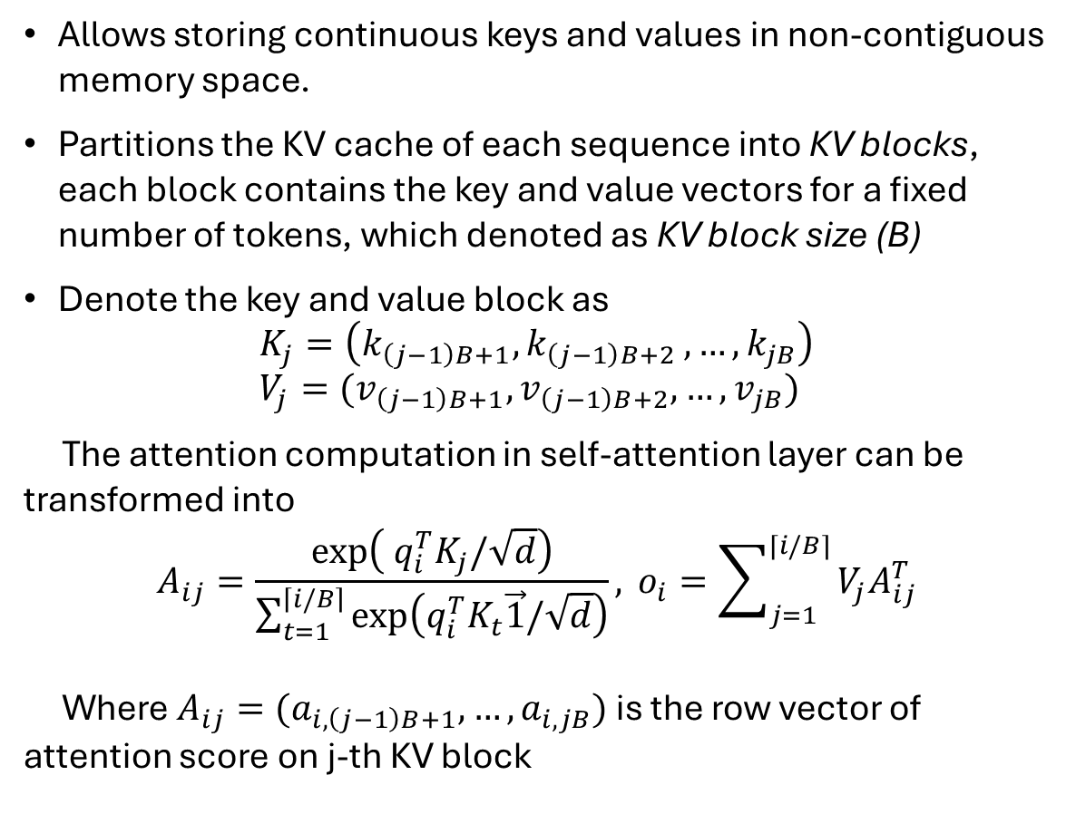
PagedAttention
Allows storing continuous keys and values in non-contiguous memory space.
Partitions the KV cache of each sequence into KV blocks, each block contains the key and value vectors for a fixed number of tokens, which denoted as KV block size (B)
Denote the key and value block as
$$K_{j}=\left(k_{\left(j−1\right)B+1}, k_{\left(j−1\right)B+2 }, …, k_{jB}\right) \\ V_{j}=(v_{\left(j−1\right)B+1}, v_{\left(j−1\right)B+2}, …, v_{jB})$$
The attention computation in self-attention layer can be transformed into
$$A_{ij}=\frac{\exp\left( q_{i}^{T}K_{j}/\sqrt{d}\right)}{\sum_{t=1}^{\left\lceil i/B\right\rceil }{\exp\left(q_{i}^{T}K_{t}\vec{1}/\sqrt{d}\right)}}, o_{i}=\sum_{j=1}^{⌈i/B⌉}{V_{j}A_{ij}^{T}}$$
Where $A_{ij}=(a_{i, \left(j−1\right)B+1}, …, a_{i, jB})$ is the row vector of attention score on j-th KV block

Slide 16
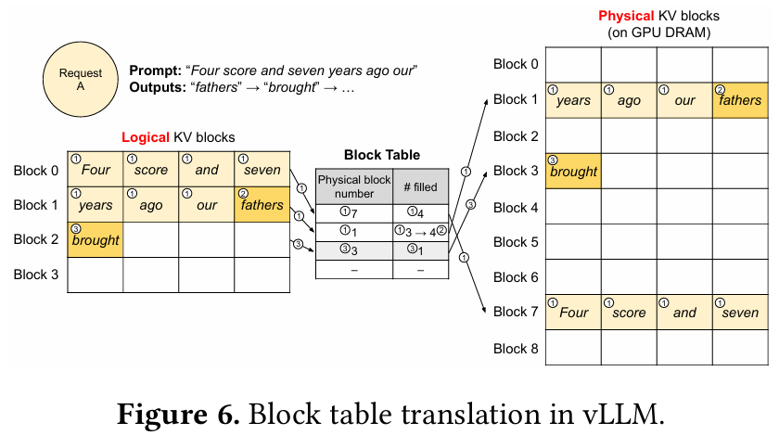
KV Cache Manager
A request’s KV cache is represented as a series of logical KV blocks, filled from left to right as new tokens and their KV cache are generated. The last KV block’s unfilled positions are reserved for future generations.
On GPU workers, a block engine allocates a contiguous chunk of GPU DRAM and divides it into physical KV blocks
The KV block manager also maintains block tables to mapping between logical and physical KV blocks of each requests

Slide 17
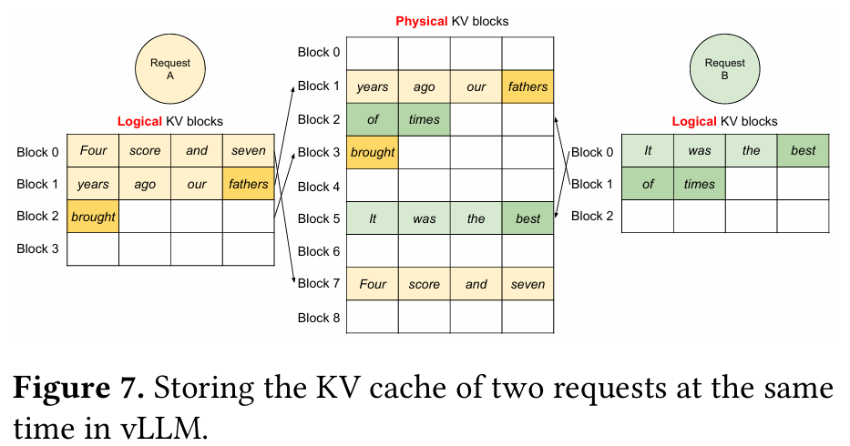
Decoding with PagedAttention and vLLM
vLLM first selects a set of candidate sequences for batching, and allocates the physical blocks for the newly required logical blocks.
Then vLLM concatenates all the input tokens of the current iteration as one sequence and feeds it into the LLM
During LLM’s computation, vLLM uses the PagedAttention kernel to access the previous KV cache stored in the form of logical KV blocks and save the newly generated KV cache into the physical KV blocks
Storing multiple tokens within a KV block allows the PagedAttention kernel to process the KV cache across more position in parallel, thus increasing the HW utilization and reducing latency

Slide 18
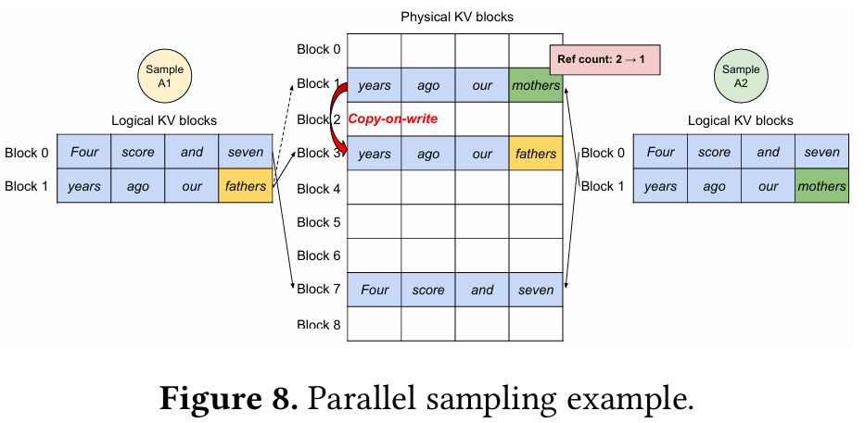
Application to Other Decoding Scenarios I.
Parallel sampling
In LLM-based program assistants[6,18], an LLM generates multiple sampled outputs for a single input prompt
In parallel sampling, one request includes multiple samples sharing the same input prompt, allowing the KV cache of the prompt to be shared as well
By introducing reference count and copy-on-write mechanism, vLLM enables the sharing of most of the space used to store the prompts’ KV cache across multiple output samples

Slide 19
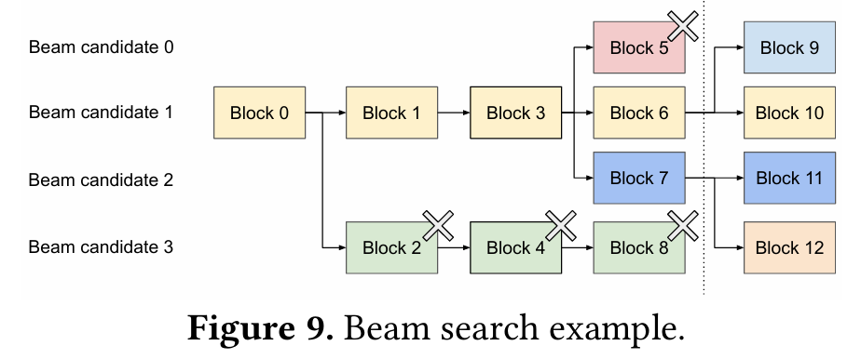
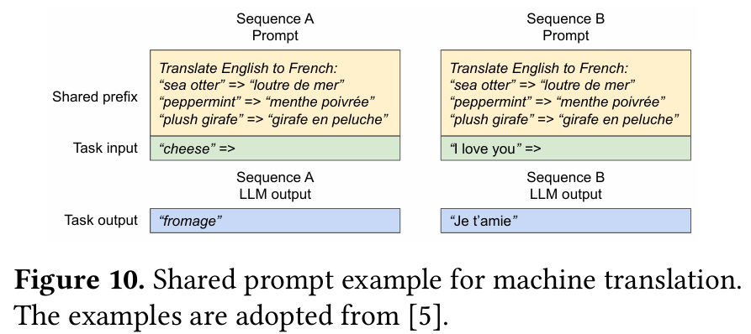
Application to Other Decoding Scenarios II.
Beam search
Keeps the top-k most likely candidate sequences at each generation step, where k is the beam width
Like Parallel sampling, vLLM using reference count and copy-on-write mechanism to handle the common prefix of each candidate
Shared Prefix (System Prompt)
Commonly, the LLM user provides a (long) description of the task including instructions and example inputs and outputs
The description is concatenated with the actual task input to form the prompt of the request

Slide 20
Scheduling and Preemption
When the request traffic surpasses the system’s capacity, vLLM must prioritize a subset of requests. It adopt the first-come-first-serve (FCFS) scheduling policy for all requests, ensuring fairness and preventing starvation
Which blocks should it evict?
Since all blocks of a sequence are accessed together, vLLM use an all-or-nothing eviction policy. Multiple sequences within one request are gang-scheduled as a sequence group
How to recover evicted blocks if needed again?
Swapping
Copy evicted blocks to the CPU memory and release the physical blocks
Recomputation
Directly release the data in physical blocks and recompute when needed again

Slide 21
Distributed Execution
Many LLMs have parameter sizes exceeding the capacity of a single GPU [5, 9]. Therefore, it is necessary to partition them across distributed GPUs and execute them in a model parallel fashion [28, 63]
vLLM uses a centralized scheduler to manage request scheduling and KV cache allocation, each GPU worker handles only a subset of attention heads
All GPU workers process the same input tokens, so they share the same logical KV cache structure
The scheduler maintains a common block table that maps logical blocks to physical blocks, and each GPU receives the same block table, but stores only the KV cache values for its assigned attention heads
Therefore, the block IDs are aligned across GPUs, while the actual KV cache contents are sharded by attention heads

Slide 22
Outline
Introduction
Background
Challenges
Method
Experiment
Conclusion

Slide 23
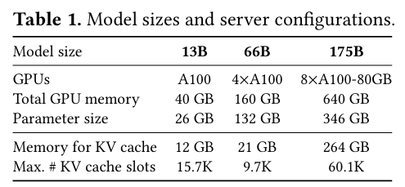
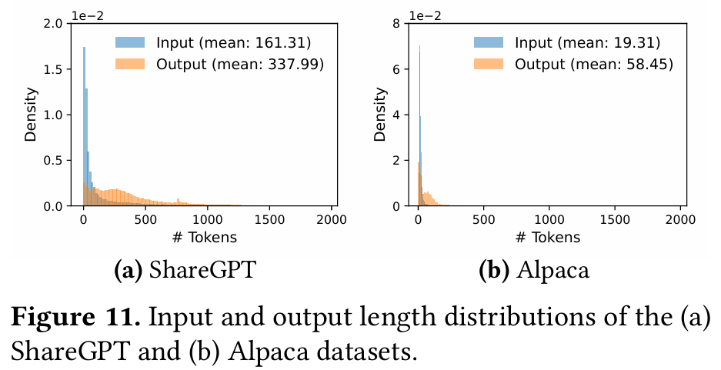
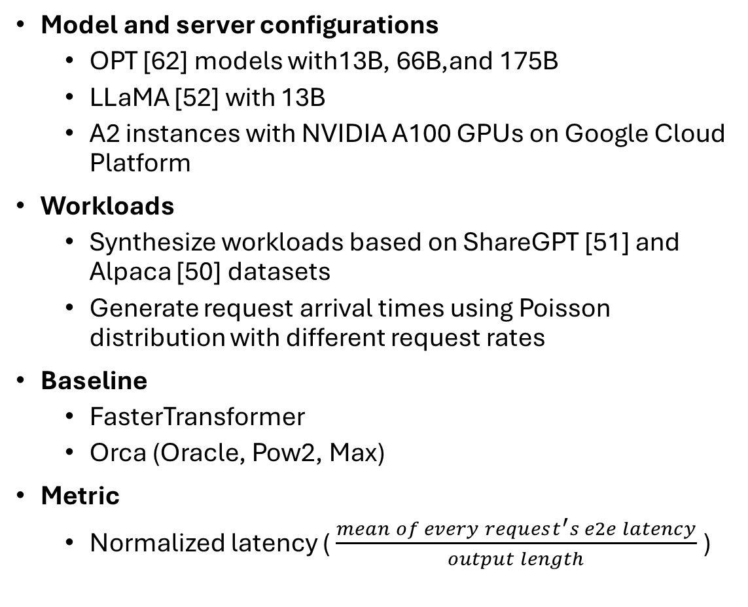
Experimental Setup
Model and server configurations
OPT [62] models with13B, 66B,and 175B
LLaMA [52] with 13B
A2 instances with NVIDIA A100 GPUs on Google Cloud Platform
Workloads
Synthesize workloads based on ShareGPT [51] and Alpaca [50] datasets
Generate request arrival times using Poisson distribution with different request rates
Baseline
FasterTransformer
Orca (Oracle, Pow2, Max)
Metric
Normalized latency ( $\frac{mean of every request^{′}s e2e latency}{output length}$ )

Slide 24
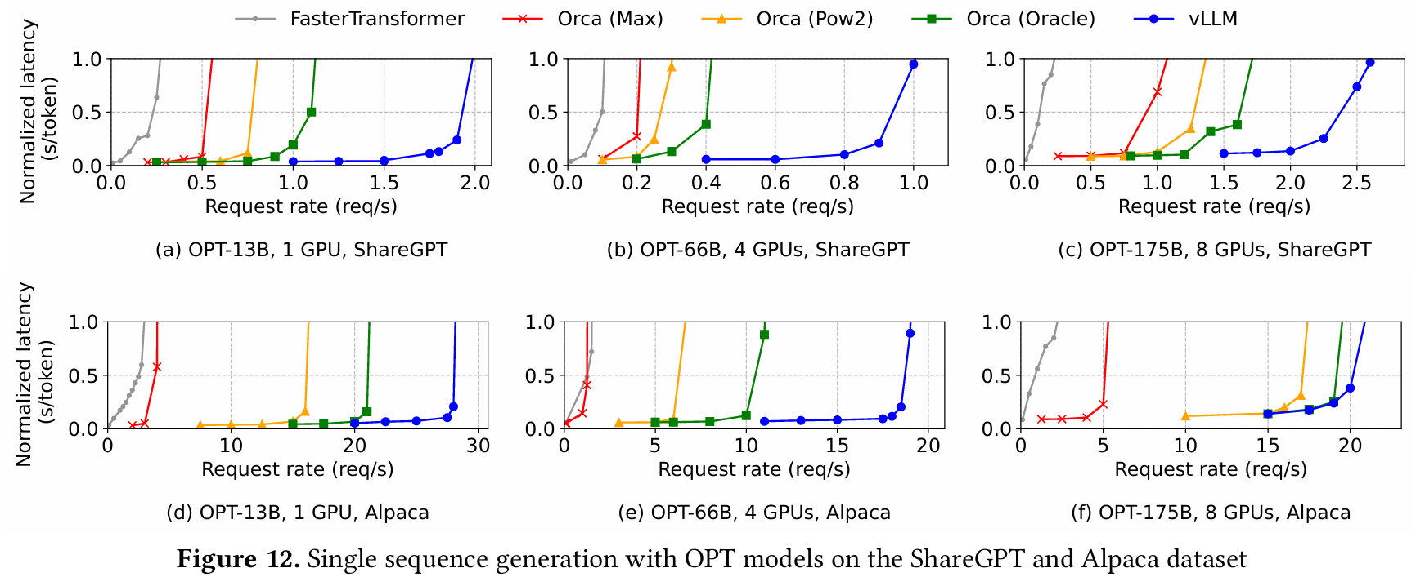
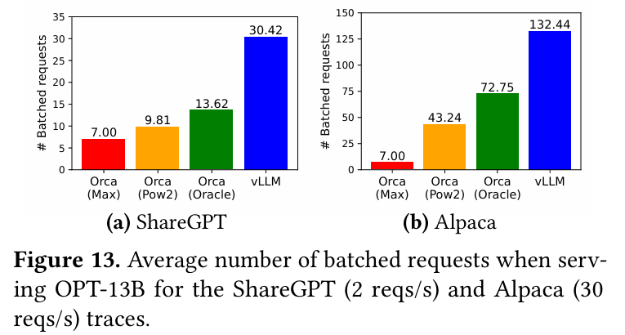
Basic Sampling
On the ShareGPT dataset, vLLM can sustain 1.7× –2.7× higher request rates compared to Orca(Oracle) while maintaining similar latencies
On the Alpaca dataset, which follows a similar trend to the ShareGPT dataset

Slide 25
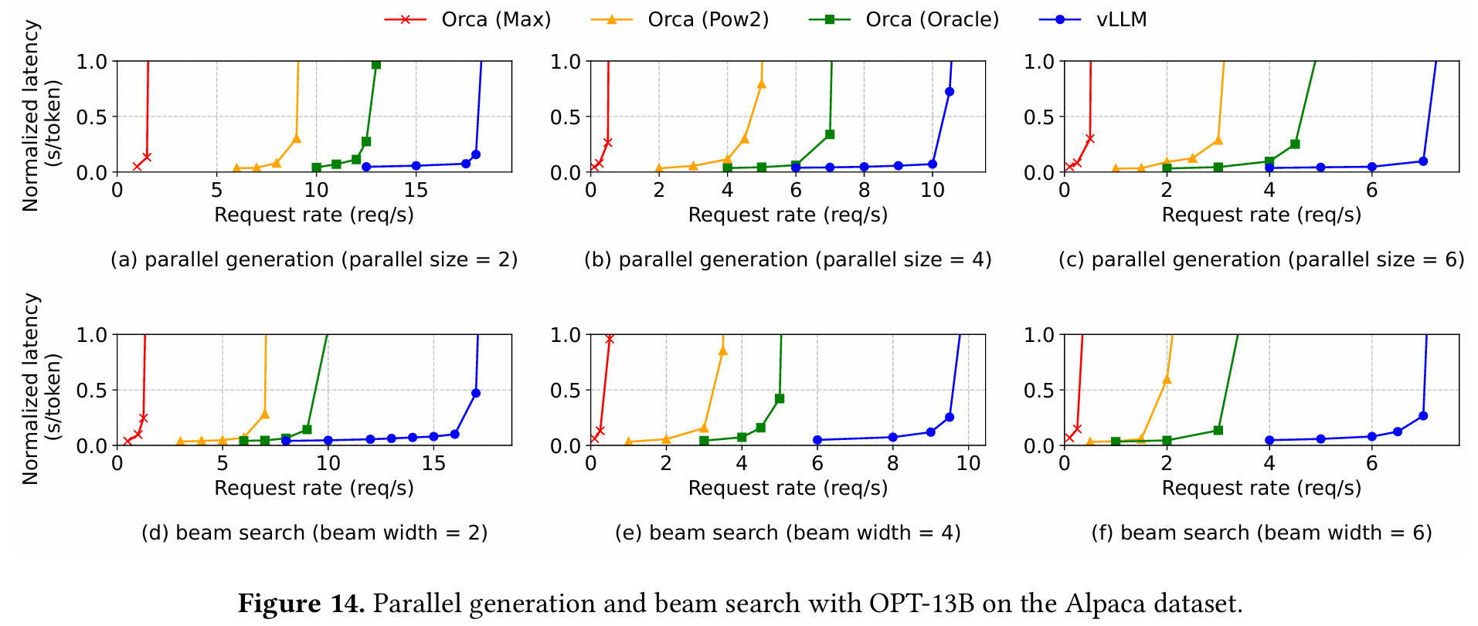
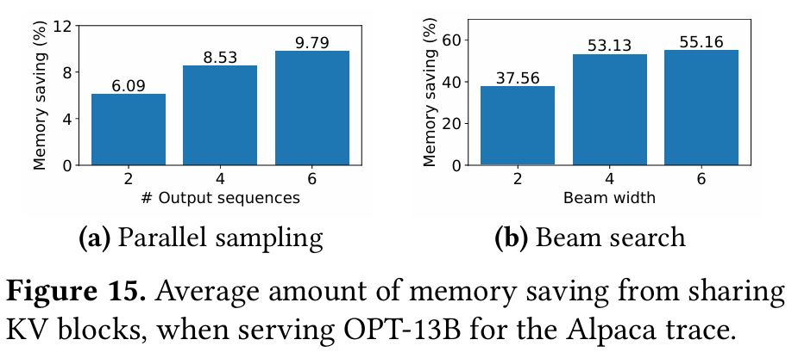
Parallel Sampling and Beam Search
In parallel sampling, since all parallel sequences in a request can share the KV cache, vLLM brings more improvement over the Orca baselines
In Beam search, it also shows the similar result to parallel sampling

Slide 26
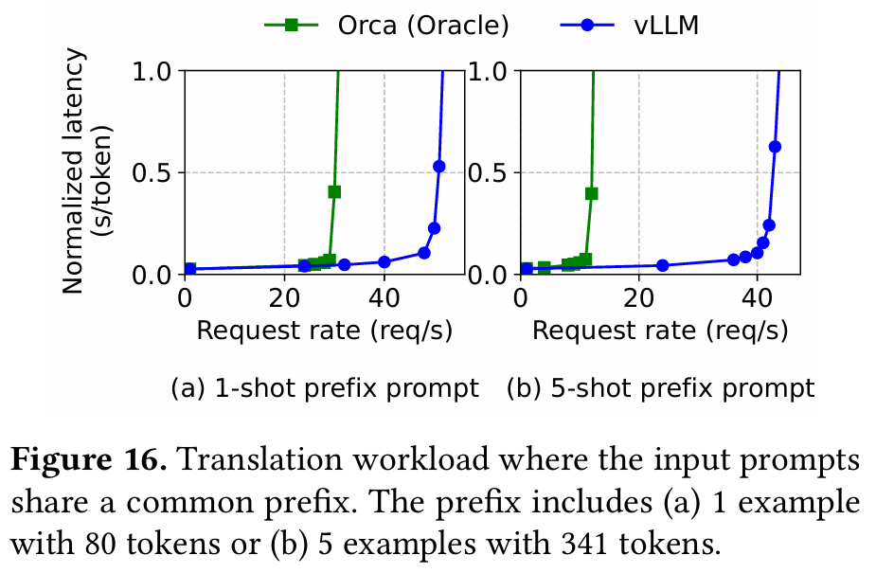
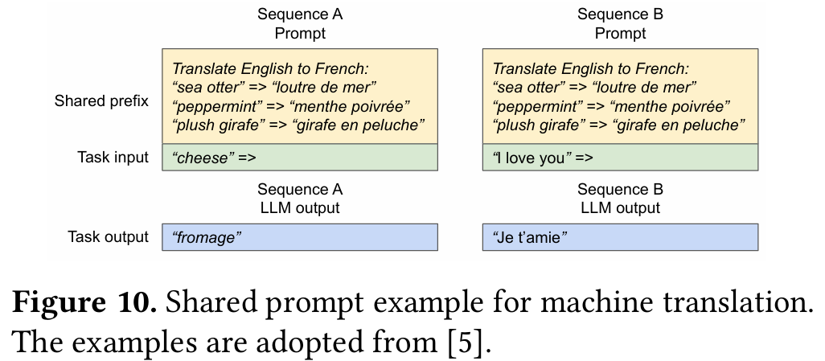
Shared prefix
Only use LLaMA-13B since it is multilingual
Use WMT 16 [4] English-to-German translation dataset and synthesize two prefixes that include an instruction and a few translation examples
vLLM achieve 1.67x higher throughput than Orca (Oracle) with one-shot
When more examples are shared, vLLM achieves 3.58x higher throughput than Orca (Oracle)

Slide 27
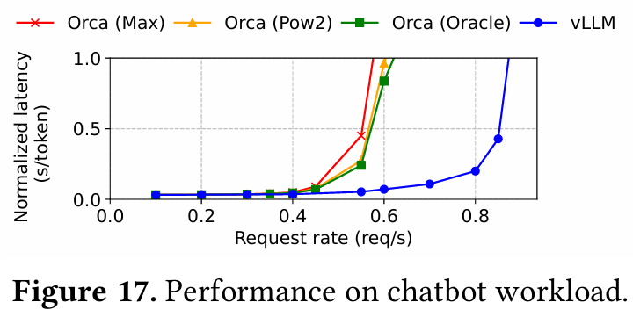
Chatbot
Let the model generate a response by concatenating the chatting history and the last user query into a prompt
Synthesize the chatting history and user query using the ShareGPT dataset
Due to the limited context length of the OPT-13B model, we cut the prompt to the last 1024 tokens and let the model generate at most 1024 tokens
vLLM can sustain 2x higher request rates compared to the three Orca baselines

Slide 28
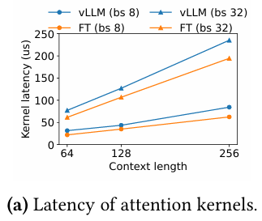
Abalation – FasterTransformer vs. PagedAttention
FasterTransformer (FT) is a distributed inference engine highly optimized for latency
Since FT doesn’t have its own scheduler, authors implement a custom one with a dynamic batching mechanism similar to Triton [30]
PagedAttention-based GPU kernel involve extra overheads of accessing the block table, executing extra branches and handling variable sequence length
From the result, PagedAttention-based GPU kernel has 20-26% higher attention kernel latency, compared to the highly-optimized FT implementation
But authors believe the overhead is small as it only affects the attention operator but not the other operators in the model

Slide 29
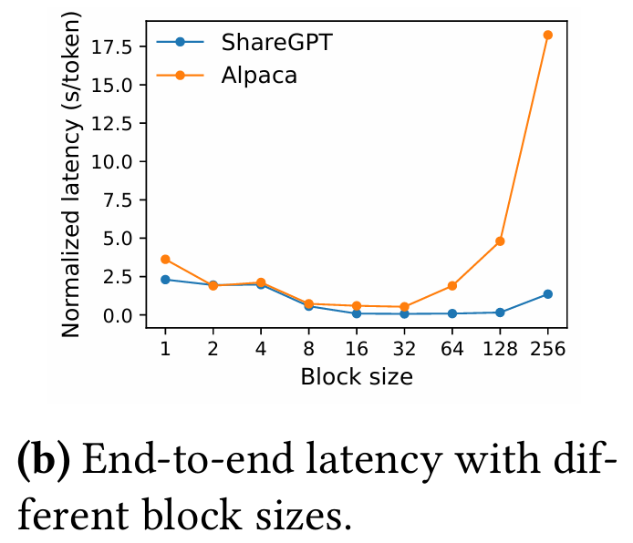
Abalation – Impact of Block Size
If the block size is too small, vLLM may not fully utilize the GPU’s parallelism for reading and processing KV cache
If the block size is too large, internal fragmentation increases and the probability of sharing decreases
From the result, the block size 16 is large enough to efficiently utilize the GPU and small enough to avoid significant internal fragmentation in most workloads. Accordingly, vLLM sets its default block size as 16

Slide 30
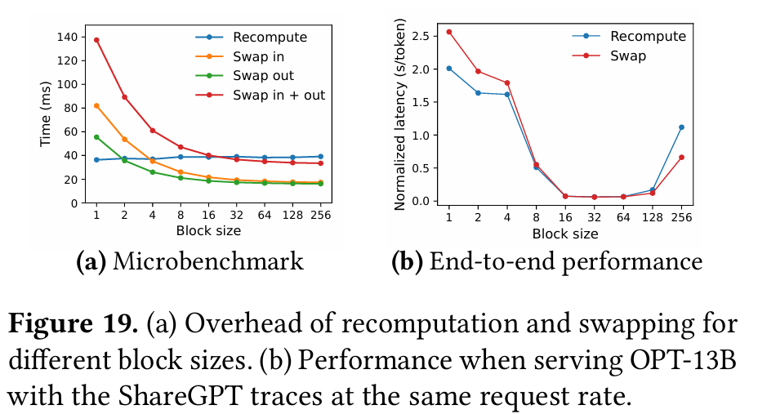
Abalation – Swapping vs. Recomputation
Swapping incurs excessive overhead with small block sizes, this is because small block sizes often result in numerous small data transfers between CPU and GPU, which limits the effective PCIe bandwidth

Slide 31
Outline
Introduction
Background
Challenges
Method
Experiment
Conclusion

Slide 32
Conclusion
Proposes PagedAttention, a new attention algorithm that allows attention keys and values to be store in non-contiguous paged memory
Presents vLLM, a high-throughput LLM serving system with efficient memory management enable by PagedAttention
Use the idea of virtual memory and copy-on-write mechanism from OS to efficiently manage KV cache and handle various decoding algorithms in LLM serving
vLLM achieves 2-4x throughput improvements over the SOTA system

Slide 33
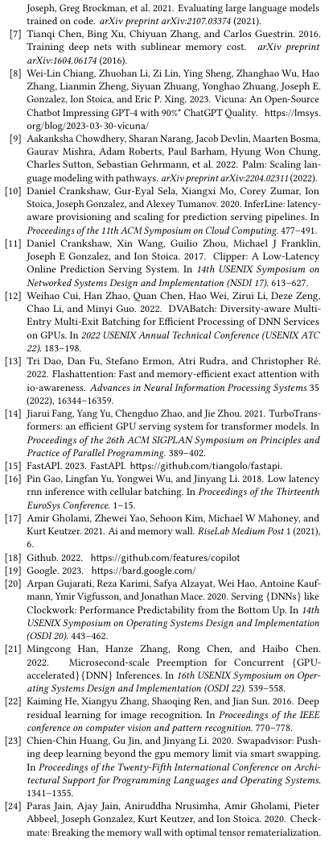
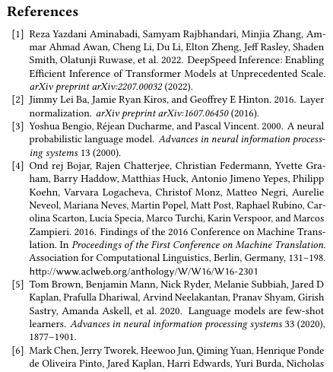
Reference

Slide 34
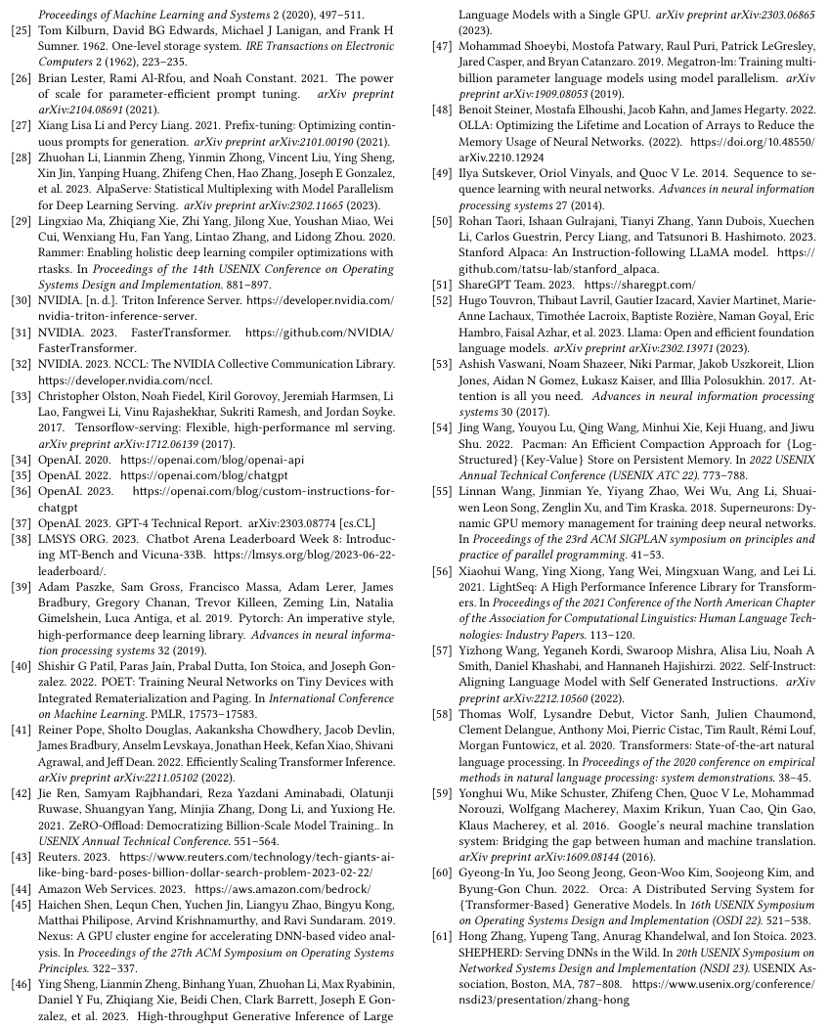
Reference

Slide 35
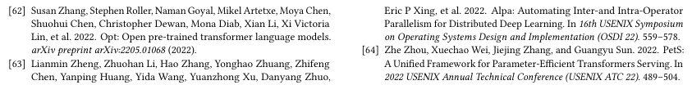
Reference

